Slide 1
Real-Time Raytracing for Interactive Global Illumination Workflows in Frostbite Sébastien Hillaire Sr Rendering Engineer EA/Frostbite

Slide 2



Outline
Context & current workflows
GI Live preview tech
DX12 + DXR APIs implementation on NVIDIA RTX technology

Slide 3












Frostbite: EA game engine
Notes:
Frostbite is EA engine used for all AAA games.
Lots of variety and different visual complexity especially when it comes to global illumination.

Slide 4

Global illumination in EA games
Geomerics Enlighten [Martin10]
Supports dynamic GI updates
Time of day
Weather updates
Moving lights
Destruction
Frostbite Flux path tracer
Fully precomputed lighting
Focus on density, quality & performance
Notes:
Enlighten allows dynamic global illumination: time of day, weather, destruction, dynamic lights, etc.
An alternative we have is high quality precomputed/static global illumination using our in house solution FLUX. It focused on quality and performance. This is especially important for our 60fps games.

Slide 5
Flux path tracer
CPU Baking process
Intel Embree
Incredibuild
See Yuriy’s talk for more details [O’Donnell18]
Thursday, March 22, 4pm
Room 3020, West Hall

Slide 6
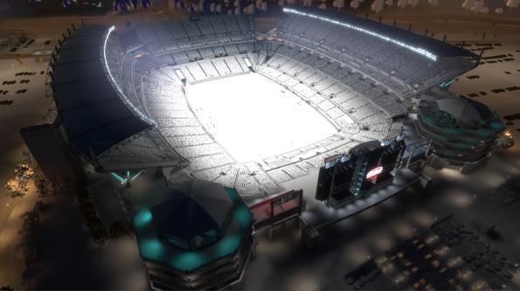
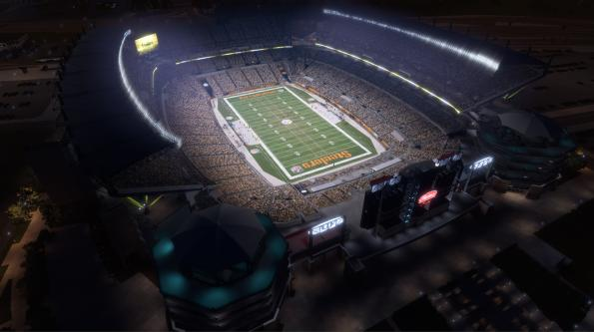
Flux in Madden
Notes:
Heinz Field, Pittsburg

Slide 7
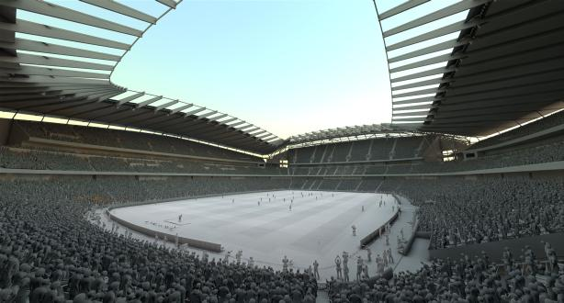
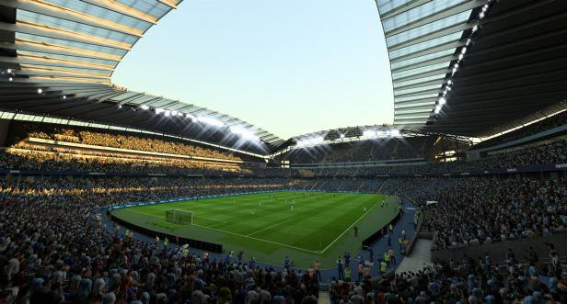
Flux in FIFA dusk
Notes:
Etihad Stadium (Melbourne, Stadium)

Slide 8
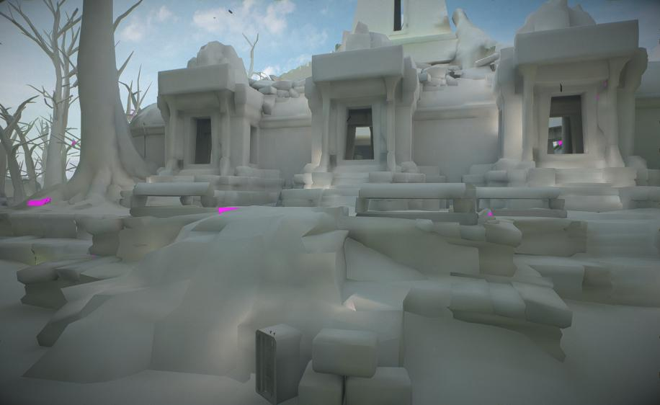
Flux in Star Wars Battlefront II
Notes:
Lightmap generated by Flux previewed here on proxy meshes.

Slide 9
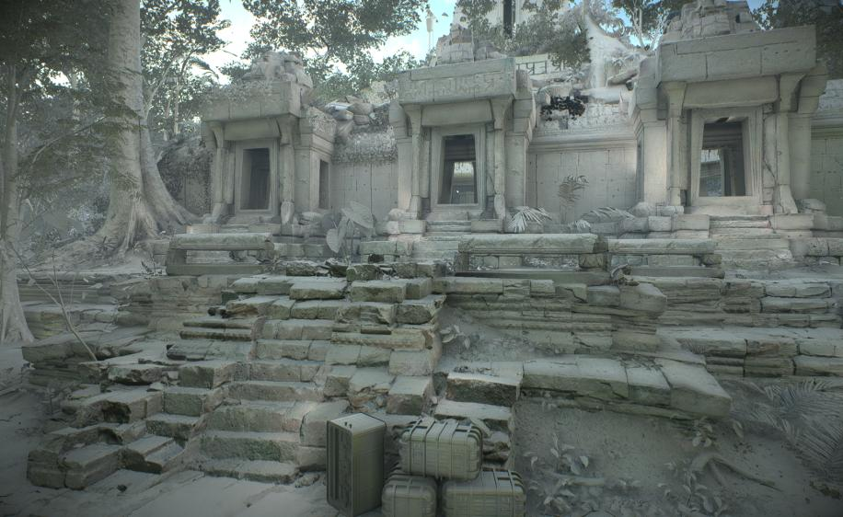
Flux in Star Wars Battlefront II
Notes:
Now on game assets with normal mapping.

Slide 10
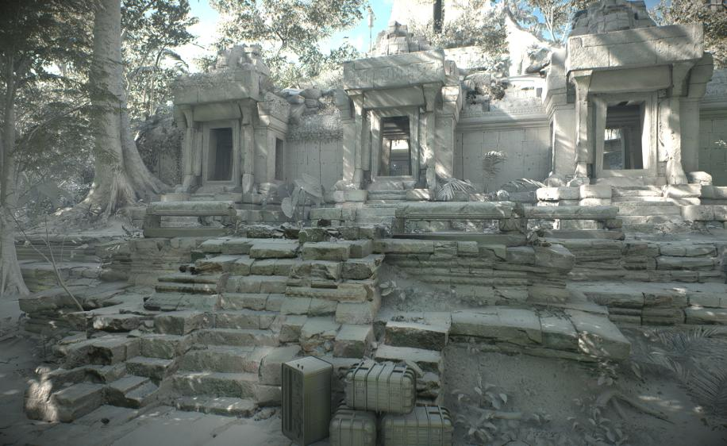
Flux in Star Wars Battlefront II
Notes:
Now with the sun light contribution added, which is the main bounce light contribution in that scene.

Slide 11
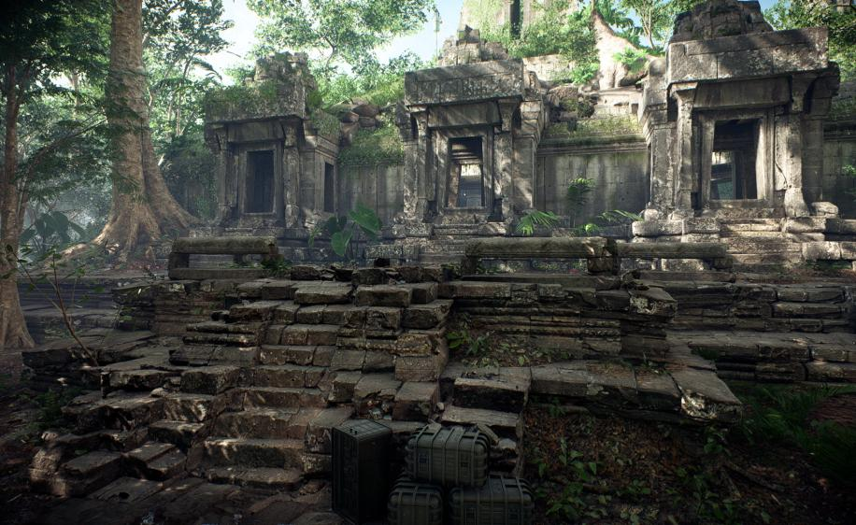
Flux in Star Wars Battlefront II
Notes:
And the final look in game.

Slide 12
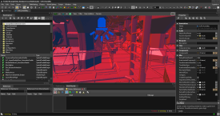
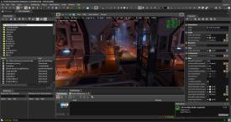
Flux workflow
Authoring
Baking
Check
OK?
Yes
In our editor FrostEd
No GI or previous GI
Minutes to hours
50k to 500k rays/texel
No
CPU GI preview too slow for our constraints
Notes:
Workflow for artist is usually:
- update a scene
- bake (which can take minutes to hours)
- review. If ok good to go to next task
If not, repeat. We tried using flux CPU path (using Embree) but this was too slow to be considered interactive according to our constraint.

Slide 13

Path tracing
$$L_{o}=L_{e} +\int_{Ω}{L_{i} ∙ f_{r} ∙\cos\left(θ\right)∙dω_{i}}$$
Tracing is parallel
Each lightmap texel is independent
Each path is independent
Perfect for GPUs
Monte Carlo integration
Incremental refinement
Perfect for preview
➔ Perfect for GPU based interactive GI preview
Notes:
Using path tracing to generate lightmap is an embarrassingly (conveniently?) parallel problem: each ray and eah texel is independent.
Also, using Monte Carlo integration, it can be used to visualize the result prograssively.
So that is perfect for GI data preview on GPU.

Slide 14
Path tracing on GPU
Flux live preview functional prototype
Using new DXR API
See Microsoft presentation for API details
GPUs with NVIDIA RTX technology
Since access to early drivers
Notes:
We thus implemented that on the convenient DXR API available now in DX12. And first on nVidia solution since we got early access to drivers.

Slide 15
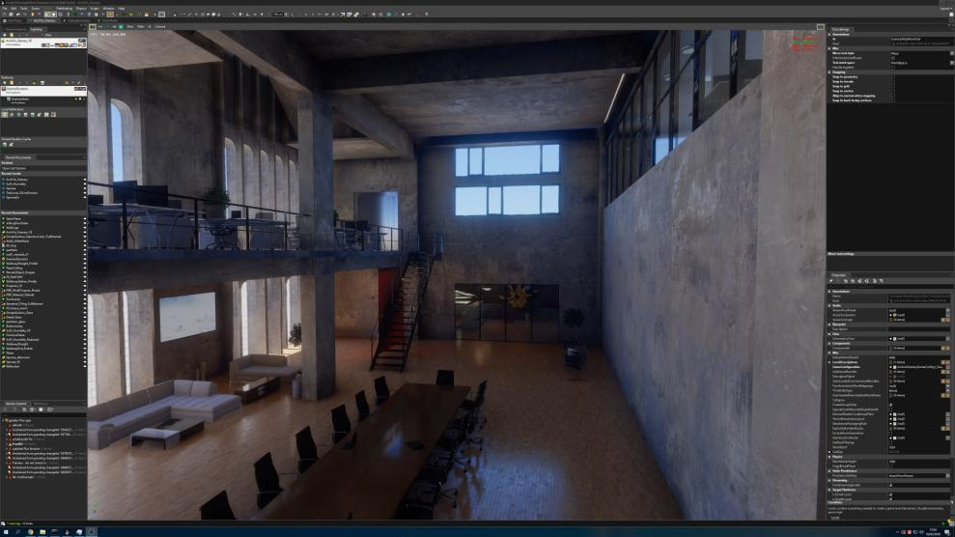
Live authoring of a scene
Credits: Evermotion - Granary
Notes:
Live update allows us to:
* Edit live
* Change material properties, for instance making a surface emissive and actually casting light.
* Move geometry
And still have proper global illumination in all these scenarii.
Popping/leaking in the lightmap due to a small bug that is now fixed ☺

Slide 16
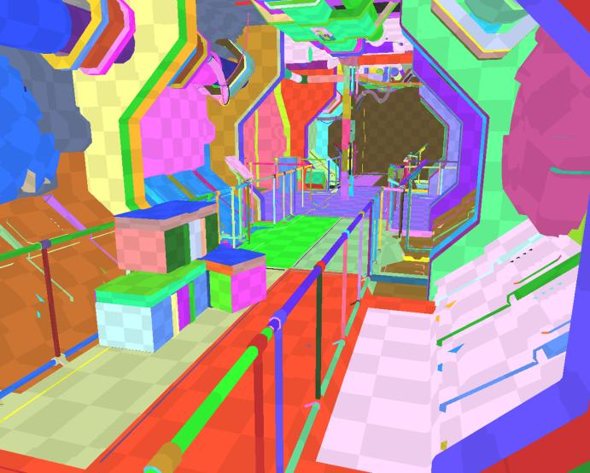
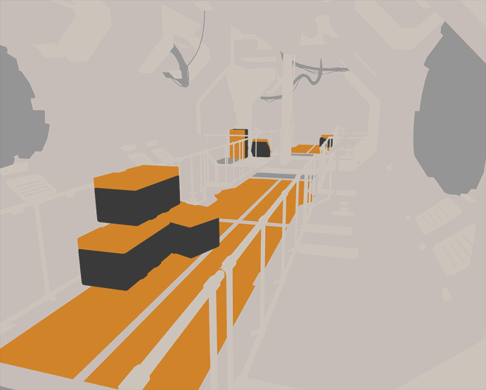
Flux DXR - input
Meshes
Triangles
Lightmap UVs
Material
Albedo
Translucency
Emissive
Every light type and sky in Frostbite
[Lagarde14] [Hillaire16]
Notes:
Light type supported:
* Punctual / area sphere light
* Punctual / area tube light
* Punctual / area rectangular light
* Punctual / area spot/disc light
We also support our composite and physically based skies.

Slide 17
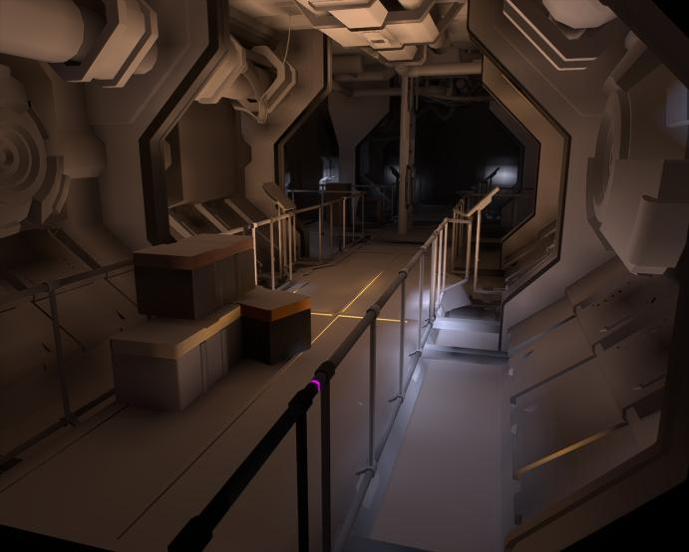
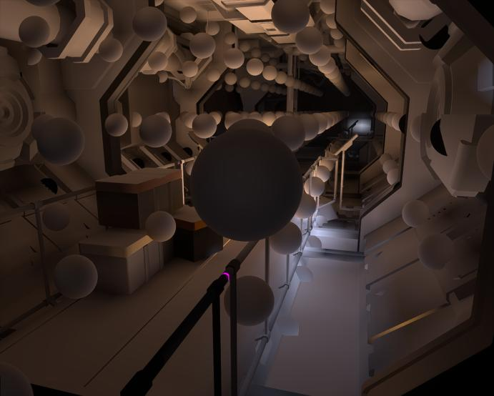
Flux DXR - output
Lightmaps
Irradiance (bounce light)
Dominant indirect light direction
Irradiance volumes
Irradiance as SH L2
Same result as real baking
Not a different algorithm
Live visualization of in-progress bake
With acceleration techniques
Notes:
Flux can output lightmaps (static meshes) and irradiance volumes (dynamic meshes, particle emitter, volumetric)

Slide 18
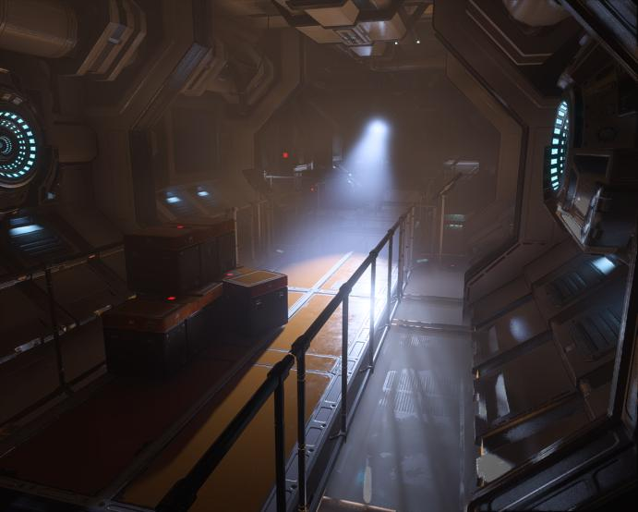
Flux DXR - Final output

Slide 19
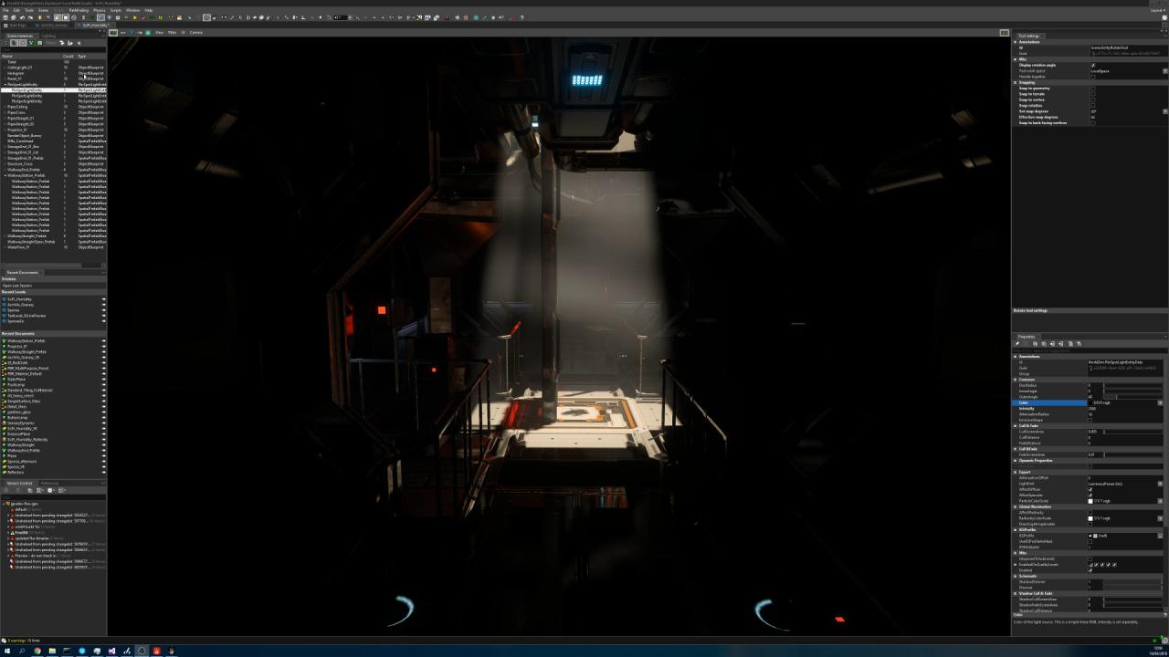
Notes:
You can see here lights being added to a scene and bounce lighting being enabled on them progressively.
The irradiance volume is used to have the bounced lighting scatter within participating media.
And you can also see the mesh albedo affecting the bounce light color.

Slide 20
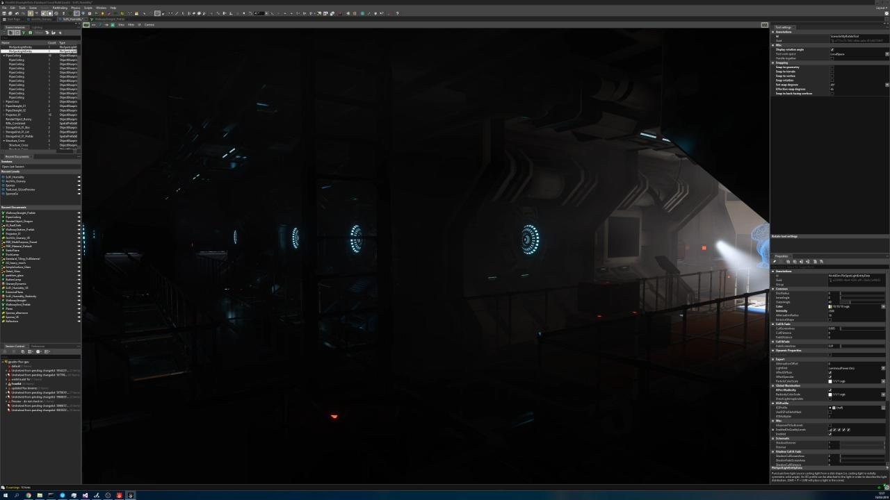
Notes:
In this video, you can see the material of some pipes in the ceiling becoming emissive. Their lighting contribution is live-updated automatically.

Slide 21
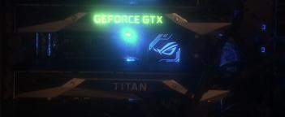
DXR - setup
Single GPU works
But Frostbite and Flux compete for it (adapt tracing budget based on frame rate)
1+1 GPUs
Frostbite on one GPU
Flux side GPU
DX12 multi-adapter mode, asynchronous
1080 GTX Ti + Titan V
GPU0
Frostbite
Frostbite
Frostbite
Frostbite
Frostbite
Frostbite
Copy
Copy
GPU1
Flux
Flux
Notes:
Best setup is multi GPU for flux and frostbite to not compete for the GPU compute resources.
Flux is running as fast as possible on the side GPU and we copy over the data as soon as a new result is available.

Slide 22
Tracing lightmap texel (1/3)
Naïve forward path tracer kernel with next event estimation
Accumulate over time / reset when lighting/object/material changed
Secondary shadow rays are incoherent and thus more expensive
Sky
Light source
Lightmap texel
Scene geometry
Notes:
For a given texel, we trace multiple paths in order to accumulate the incoming light.
The path origin is jittered spatially and directionally.
Along each path, at each vertex, we sample the surrounding local light sources (a.k.a. next event estimation).
When the path no longer intersects any geometry we evaluate the sky contribution.
Doing the next event estimation, and in particular doing the visibility checks (i.e. shadow rays) is quite expensive due to incoherent ray-traversal within a given warp.

Slide 23
Tracing lightmap texel (2/3)
Use (naïve) irradiance cache for direct light (sun, local light, emissive)
Cache filled in over multiple frames when lighting condition changed
Sampling next event along the path becomes a simple texture fetch.
Light source
Lightmap texel
Scene geometry
Notes:
Instead we use a naïve irradiance cache approach, in which direct lighting is first stored into a separate cache texture (using the same parametrization as the lightmap) prior to tracing the lightmap texels themselves.

Slide 24
Tracing lightmap texel (2/3)
Use (naïve) irradiance cache for direct light (sun, local light, emissive)
Cache filled in over multiple frames when lighting condition changed
Sampling next event along the path becomes a simple texture fetch.
Sky
Light source
Lightmap texel
Scene geometry
Notes:
When computing texel lighting, we do the same tracing as described on slide 22, but now the next event estimation is replaced by a simple texture lookup, avoiding expensive lighting & visibility evaluation.
This obviously introduces some bias, but the ratio of performance gain / quality lost, is really high.

Slide 25
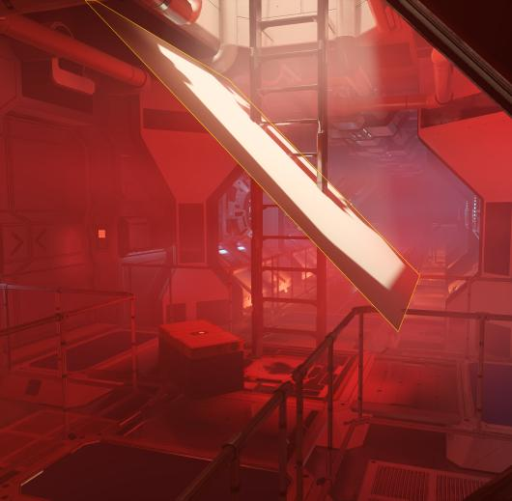
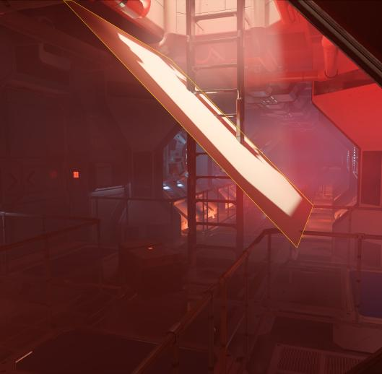
Tracing lightmap texel (3/3)
Translucency support on thin surfaces
becomes cheap
Opaque
Translucent
Lightmap texel
Notes:
Due to the irradiance cache, translucent materials can be evaluated cheaply, as the irradiance cache provides the converged value, rather than casting extra paths for evaluating it.

Slide 26
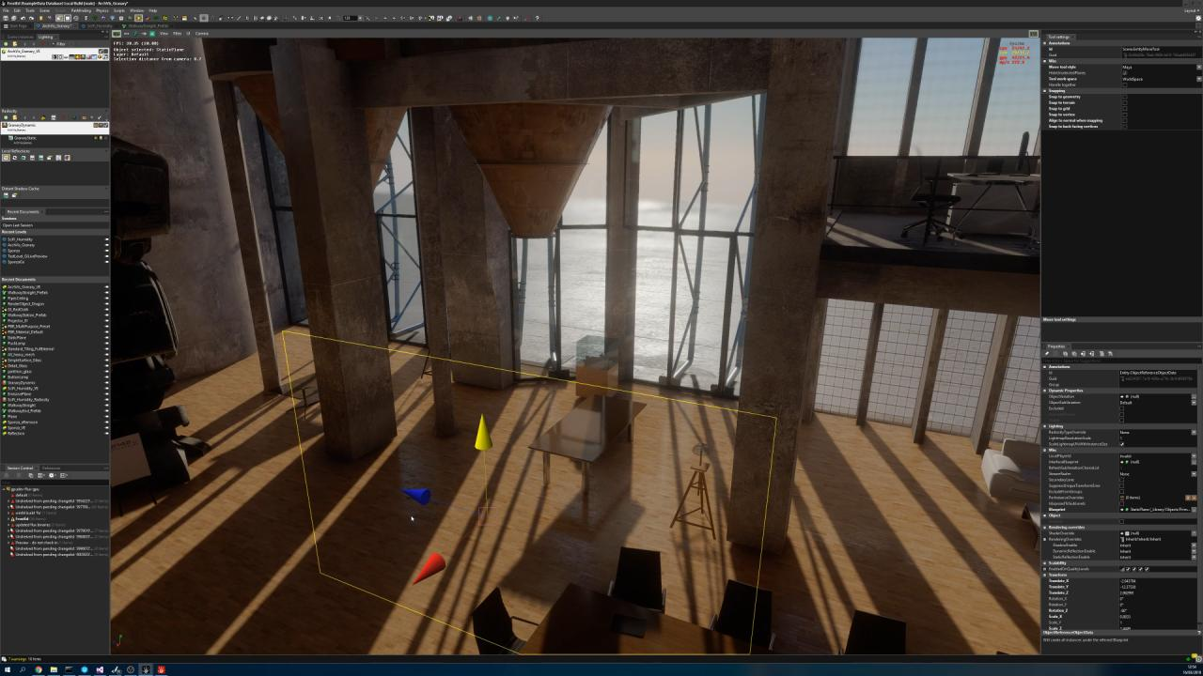
Credits: Evermotion - Granary
Notes:
Here is an example of a translucent material being moved, and showing its contribution update live.
Popping/leaking in the lightmap due to a small bug that is now fixed ☺

Slide 27
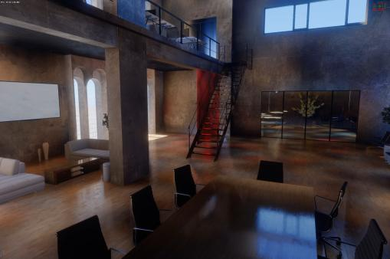
View Prioritization
Tracing is expensive: preview only what is visible
Render/update only visible texels:
Trace rays from camera to scene
Schedule hit texels
Fast: 1.3M paths scheduled in 0.15ms
(Titan V)
Slowed down by a LOT for demo purposes
Notes:
Before dispatching the lightmap texels, we do a view prioritization step which traces a given amount of rays into the scene and schedules the intersected texels for rendering. In the slowed down video you can see how texels only start rendering when they become visible

Slide 28
Battling Noise (1/3)
Forward path tracer has a lot of noise (variance)
Track (running) variance per texel in order to know when a texel has converged. This is used for:
Balancing tracing budget where it matters in the frame
(do not schedule converged texels)
Denoising lightmap

Slide 29
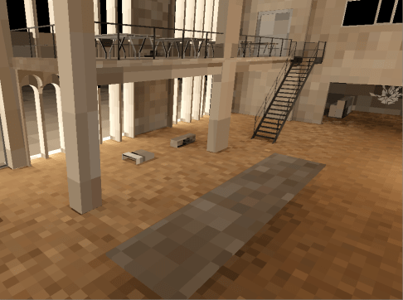
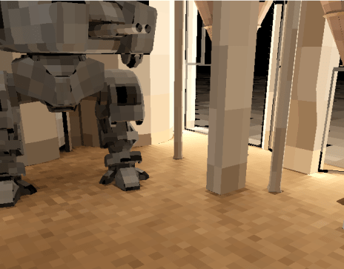
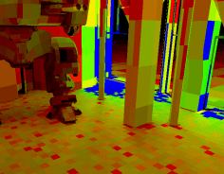
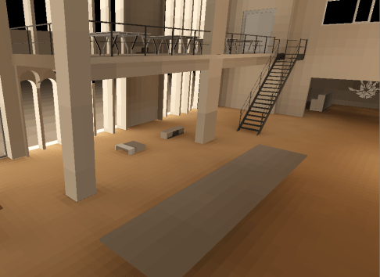
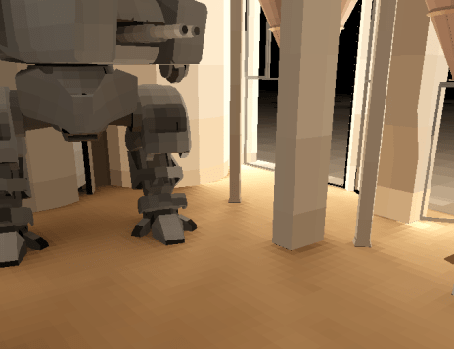
Battling Noise (2/3)
Denoising lightmap
Use a hierarchical A-Trous filter in lightmap space [Schied17]
Applied every frame on the lightmap* before presented to the user
Denoising is faded out as texel converged
Estimated convergence
* The actual lightmap is kept untouched for not biasing the convergence
Credits: Evermotion - Granary
Credits: Evermotion - Granary

Slide 30
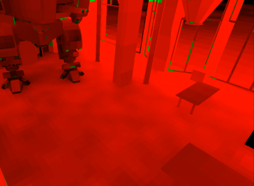
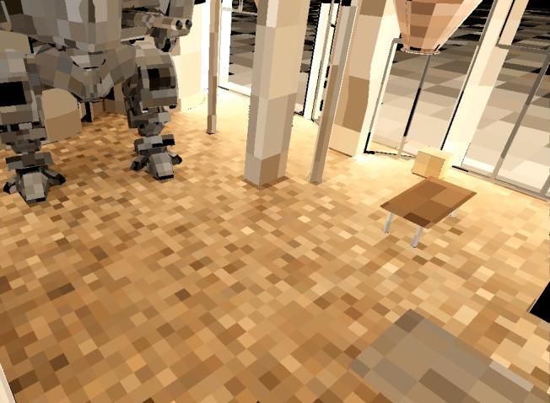
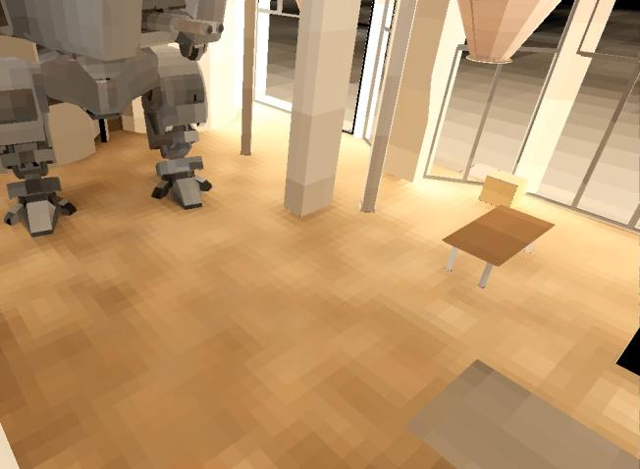
Credits: Evermotion - Granary
Convergence
Raw
Denoised
Notes:
Note: in denoised version, we used a non-hierarchical version of the wavelet denoise presented by [Schied 2017]

Slide 31
Battling Noise (3/3)
Future
Mix image & lightmap space denoiser for reducing light leaks
Add converged texel to an indirect irradiance in order to shorten path
Sky
Lightmap texel
Direct & Indirect
Irradiance cache

Slide 32
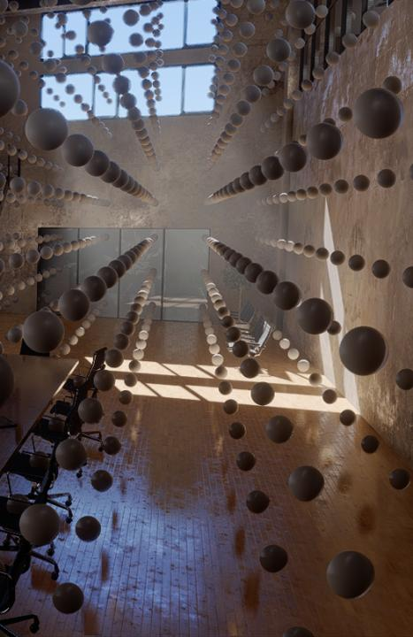
Irradiance volumes
Trace probe irradiance of visible volumes
Store irradiance into Spherical Harmonic L2
Use the same integrator as for texels
Credits: Evermotion - Granary

Slide 33
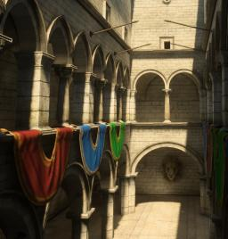
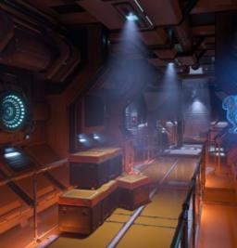
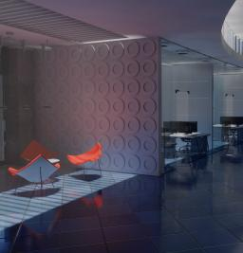
Performance on Titan V
Only Sun
Many Lights
Sun + Sky
Credits: Dabrovic D. & Meinl F.
Credits: Evermotion - Granary
 | Sponza | SciFi | ArchVis
Default | 150 | 70 | 135
+ View Prioritization | 220 | 100 | 280
+ Irradiance Cache | 250 | 300 | 320
Performance in million ray / seconds
Notes:
The second scene (SciFi) really shows off how the irradiance cache speeds up the rendering when there are otherwise many lights to evaluate during path-tracing of multiple bounces.

Slide 34
Future thoughts
Path tracing improvement
Bi-directional tracing
Better irradiance cache representation,
Path guiding for long paths [Vorba14]
1+N GPUs
Different random seeds per GPUs
GPU farm
High quality bakes
Shared on-demand bake resources
Notes:
All the research done in the path tracing field could be used now to improve real time preview of GI data.

Slide 35
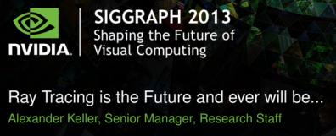

Conclusion
Interactive GI preview implemented using DXR API
Benefits
Faster iterations, interactive, a matter of seconds
More time for artists to produce high quality scenes
?
?

Slide 36

Questions?
Frostbite
Diede Apers
Charles de Rousiers
Per Einarsson
Sebastien Hillaire
Yuriy O’Donnell
Alban Wood
DICE
Oscar Carlen
Tilmann Milde
EA Sports
Michael Day
Joe Warren
Philip Zborovsky

Slide 37
Other EA talks
Thursday, 10:00am
Real Player Motion Tech in 'EA Sports UFC 3
Geoff Harrower
Thursday, 11:30am
Deep Learning: Beyond the Hype
Magnus Nordin
Thursday, 3:00pm
Cloth Self Collision with Predictive Contacts
Chris Lewin
Thursday, 4:00pm
Precomputed Global Illumination in Frostbite
Yuriy O'Donnell
Friday, 10:00am
Frostbite GPU Emitter Graph System
Sebastien Hillaire & Anders Egleus

Slide 38
Previous work
[Hillaire16] Sebastien Hillaire, Physically Based Sky, Atmosphere & Cloud Rendering, SIGGRAPH 2015
[Lagarde14] Sebastien Lagarde and Charles de Rousiers, Moving Frostbite to Physically based rendering, SIGGRAPH 2014
[Martin10] Sam Martin and Per Einarsson, A Real Time Radiosity Architecture for Video Games, SIGGRAPH 2010
[O’Donnell18] Yuriy O’Donnell, Precomputed Global Illumination in Frostbite, GDC 2018
[Vorba14] Jiri Vorba et al., On-line learning of parametric mixture models for light transport simulation, ACM TOG 2014

Slide 39
Bonus

Slide 40
Adapt tracing budget
Tracing cost can vary a lot between frames (paths length/coherence)
On single GPU machine
Cap tracing under a fixed budget (e.g.16ms)
Adapt the number of texels/samples based on previous frame timers. This allows to keep frame rate smoother
On multi-GPU machine
1 GPU is allocated to FB, the other GPUs are allocated to the GI preview. The "GI" GPUs work in async and thus tracing budget is uncapped (in order to provided valid result as fast as possible).

Slide 41
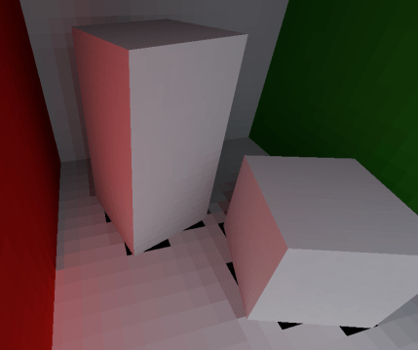
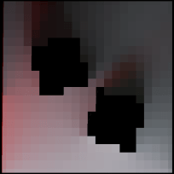
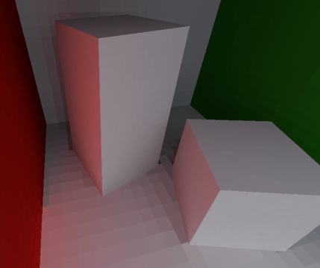
Filter invalid texels
Lightmap can contain invalid texel data (samples within geometry)
Use dilation with lightmap chart for filling invalid pixels
Applied at every lightmap iteration

Slide 42
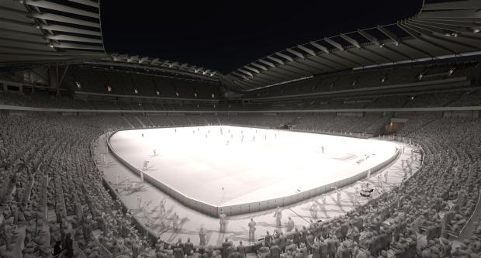
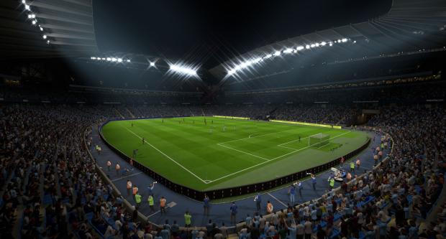
Flux in FIFA night time
Notes:
Etihad Stadium (Melbourne, Stadium)

